Slide 1
Senior Software Engineering Project (Mobile Application Team)
Spring 2013
Team Members: Corey Young, Mason Reams, Thomas Heckwolf
Team Lead: Erin Corona
Instructor: Dr. Adam Lewis

Slide 2

Statement of Work
Mission
Provide a statement of work for the mobile application
Research methods for providing a reliable product to our customer
Identify our customer’s wants and needs
Agile development

Slide 3


Requirements Analysis and Purpose
Mobile application for the annual fall Fiddler’s Convention
Display similar data as digital signage

Slide 4




Scope of Work
Easy to use application
Technology
Android
MySQL
PHP
Eclipse
Other Teams
Back stage group

Slide 5



Location of Work
Google Drive
Temporary Documents
Team Sharing
Trac
User Stories
Subversion
Document Control
Released Software
Released Documents

Slide 6
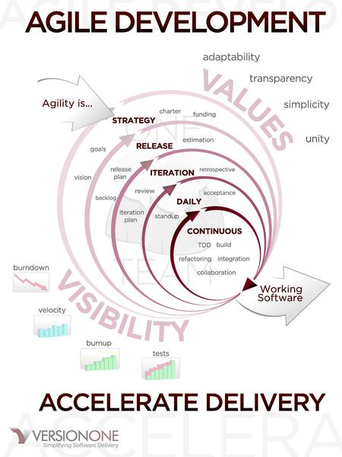
Period of Performance
Agile Development
Iterations
3 Iterations
4-6 Weeks

Slide 7
Implementation
Iteration 1
User Stories
Statement of Work
Storyboard
Setup Azure Cloud Database
Get Mobile App Connected to the Database
Iteration Testing
Iteration 2
Begin Displaying Information From Database
Add Graphics and Animation
Add Refresh Button
Iteration Testing
Iteration 3
Add Separate Section to Display History of OTFC
Add Link to OTFC Website That Will Open Browser
Add Separate Section To View Webcam Off Athens Website
Iteration Testing

Slide 8

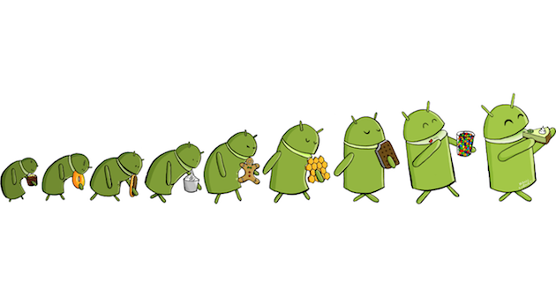
Applicable Standards
Follow policies set by Google Play
Policies set by Athens State
Policies set Fiddlers Convention

Slide 9

Development Team Meetings
Who
Mobile Application Team
What
Development Team Meeting
When
Sundays @ 11:00am
Where
Google Hangouts
Why
To Standup

Slide 10
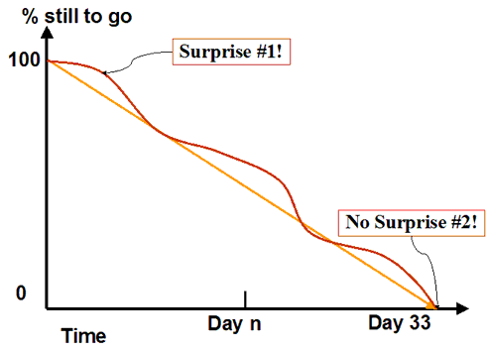
Acceptance Criteria and Testing
Based on User Stories
Burn Down
Testing
Every Iteration

Slide 11


Cost
BYOD (Bring Your Own Device)
Free…….

Slide 12
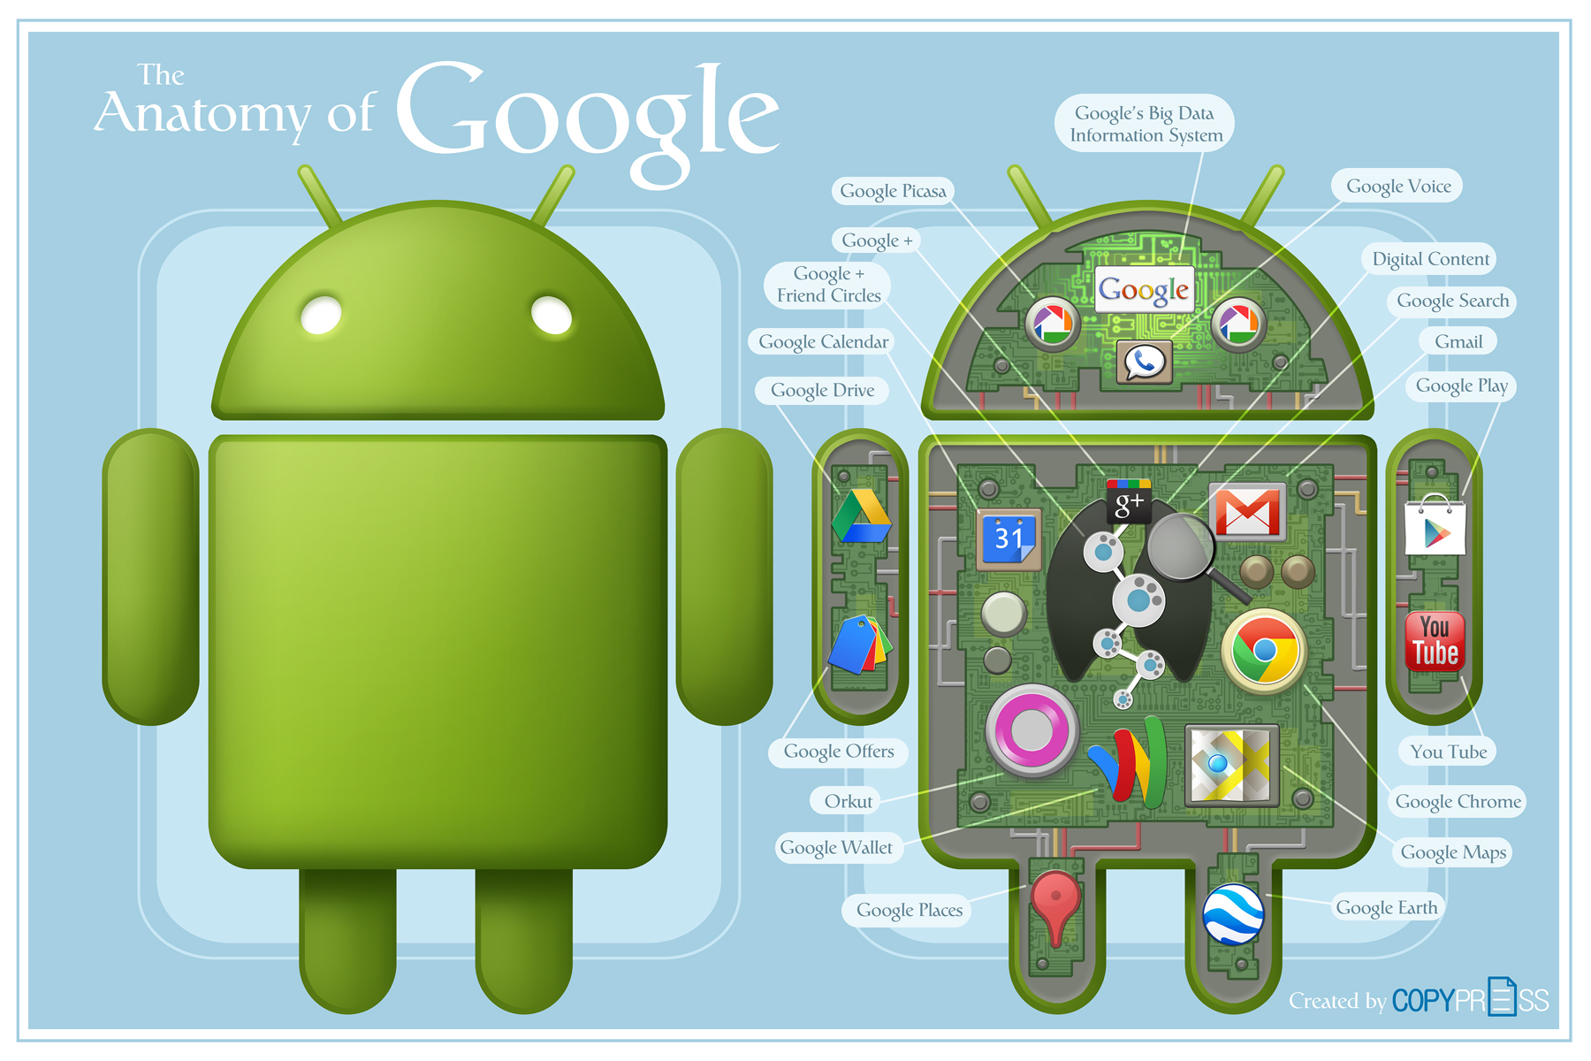
Miscellaneous

Slide 13
Disclaimer
Google , Google Logo , Android , and Android Logo are registered trademarks of Google Inc. © 2012 Google Inc. All rights reserved.
PHP Logo , Copyright © 2001-2013 The PHP Group.
Eclipse Logo , Copyright © 2013 The Eclipse Foundation. All Rights Reserved.
Trac Logo, Copyright © 2003-2012 Edgewall Software. All rights reserved.
Subversion Logo , Copyright © 2012 The Apache Software Foundation
MySQL Logo , © 2013, Oracle Corporation
Agile Image , © 2013, VersionOne, Inc. All Rights Reserved
Fiddlers Logo and Images , Copyright © 2013 Tennessee Valley Old Time Fiddlers Convention. All Rights Reserved.
Athens State University Logo , Copyright © 2012 Athens State University

Slide 14
Questions ?????

